Slide 1
BATCH 2
WEEK 2 REPORT

Slide 2
WEEK’S OBJECTIVES
1. FINISH MACHINING 2ND CASING
2. FINALIZE INSTALLEMENT OF POLYCARBONATE SHEETS ON TEST STAND
3. CREATE A GANTT CHART
4. PROOF THAT THE BOLTS AND O-RINGS METHOD IS SUFFICIENT FOR CASING , NOZZLE & BULKHEAD JOINING.
5. COOK A TEST GRAIN.
6. REFINE LOAD CELL READING AND VALUE TRANSMISSION CODE.

Slide 3
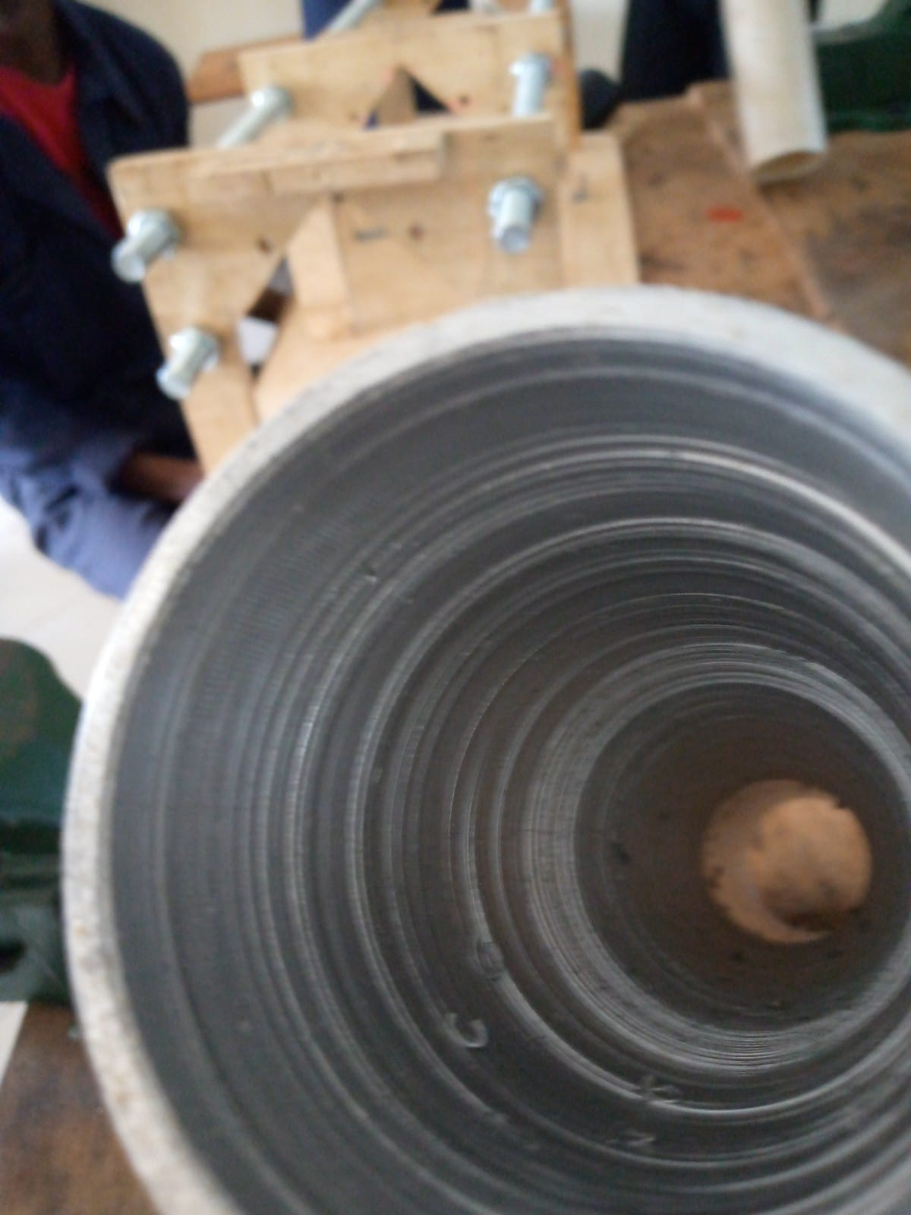
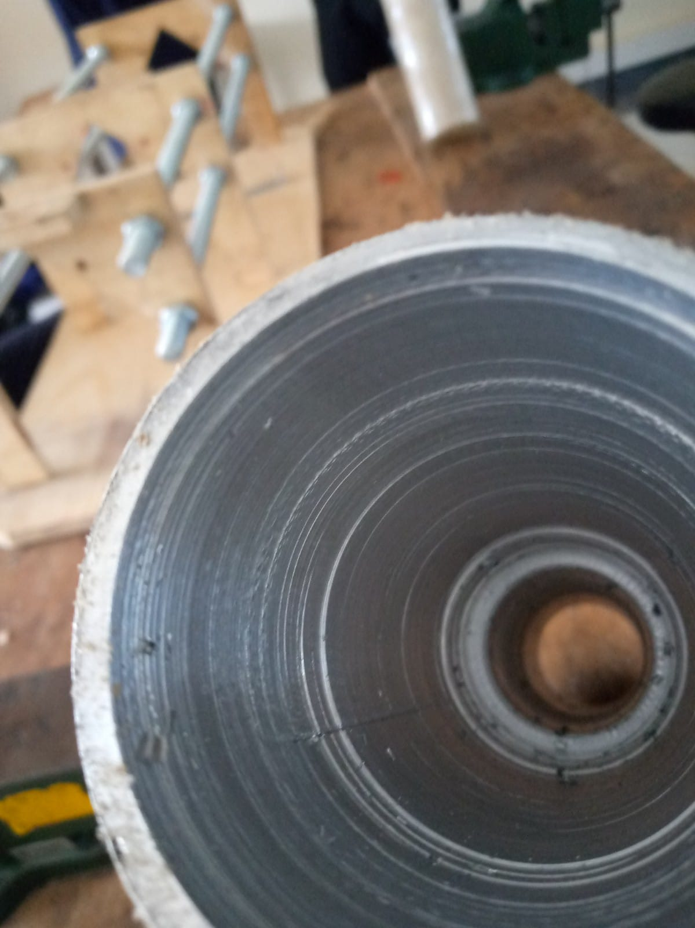
FINISHED MACHINING OF THE SECOND CASING
Temporarily paused fabrication.
Awaiting a proper boring tool
but the work is almost complete

Slide 4
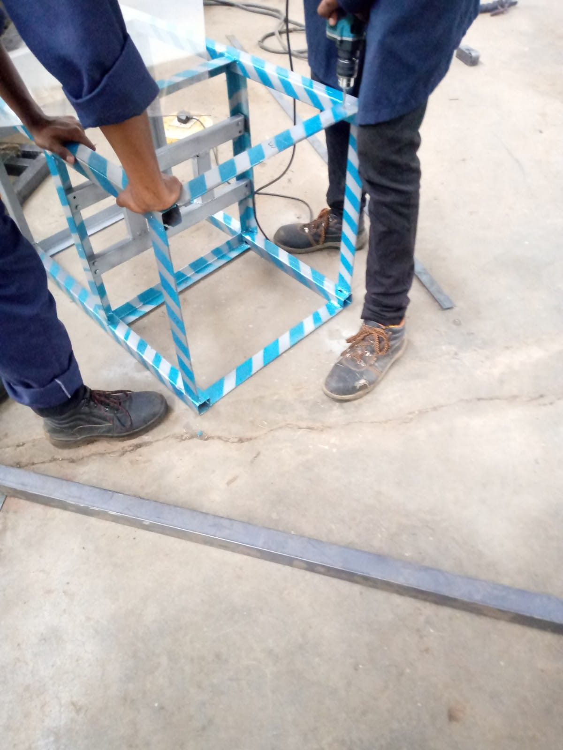
COMPLETED INSTALLEMENT OF POLYCARBONATE SHEETS
Need:
-20 m6 bolts needed for complete assembly.
- Mesh for top part

Slide 5
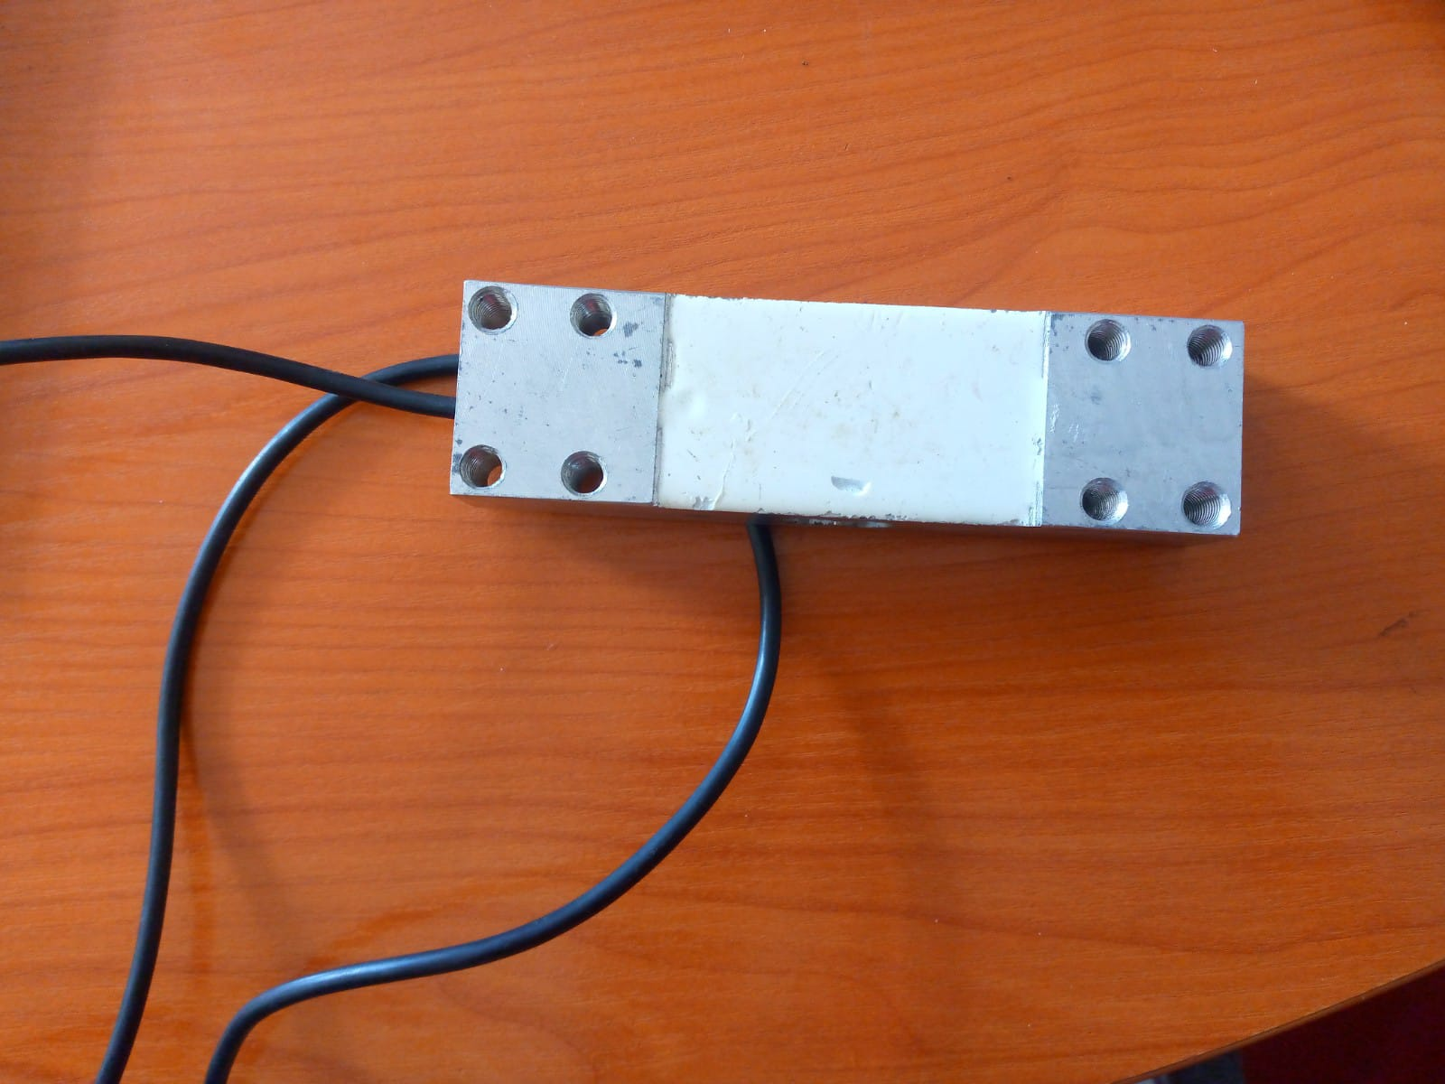
EXAMINED AND REFINED LOAD CELL CODE
https://gist.github.com/Collins-Omariba/2d21948d538d4a60c9a962925e4371f2
https://gist.github.com/Collins-Omariba/1e220c2707260a9d6de4eb6ad4a623cc

Slide 6
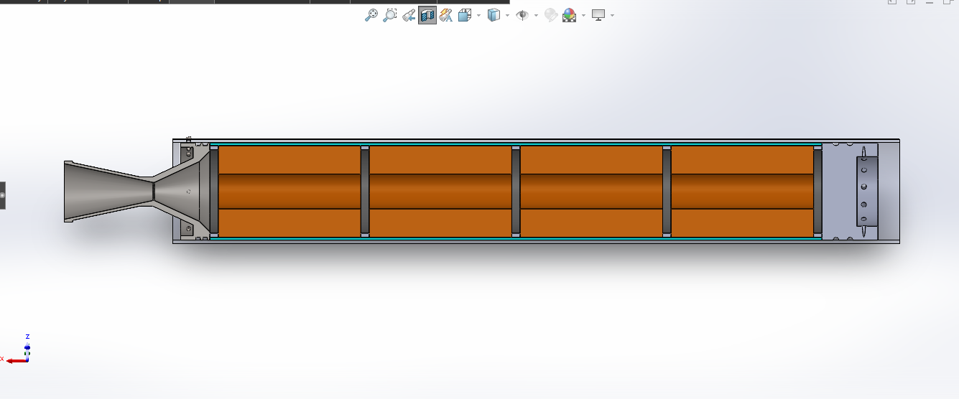
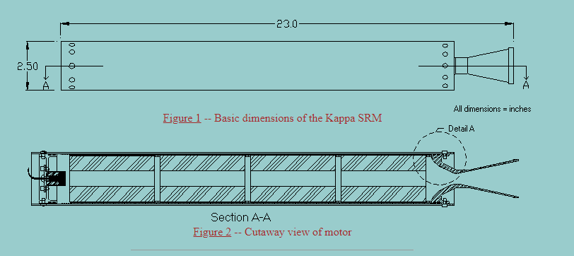
SOLID MOTOR ASSEMBLY
OUR DESIGN
KAPPA MOTOR ON NAKKA’S WEBSITE

Slide 7
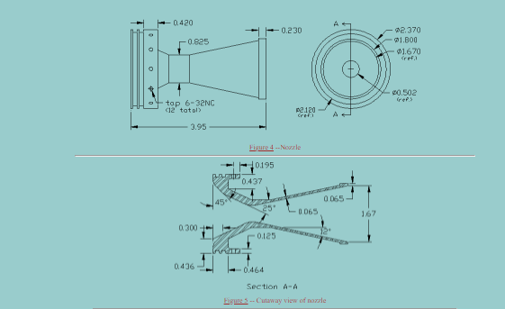
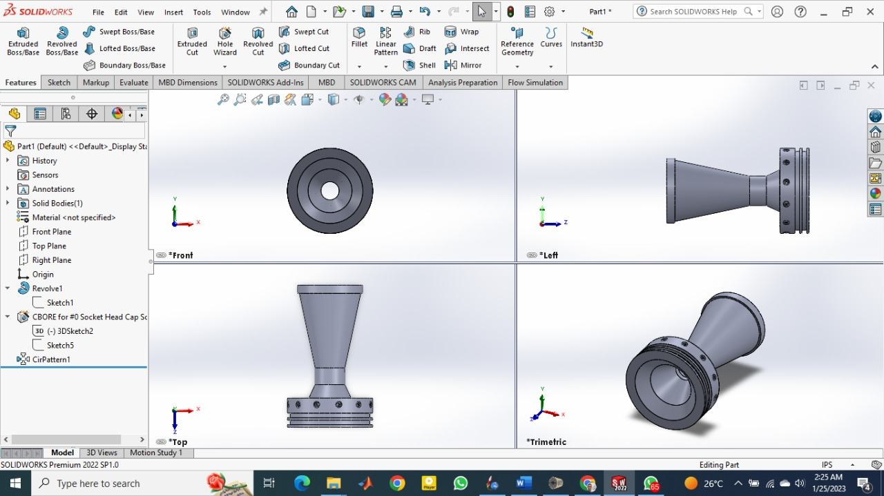
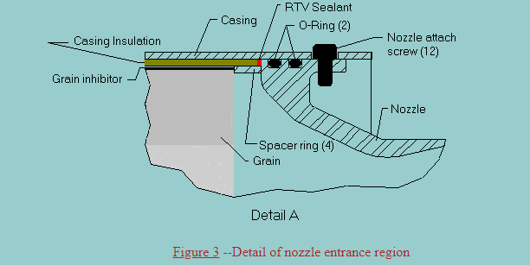
NOZZLE & JOINING MECHANISM
OUR DESIGN
KAPPA MOTOR ON NAKKA’S WEBSITE
The comparison between the 2 proves that the method of joining using bolts & O-rings will work.
- Currently working on the calculations.

Slide 8
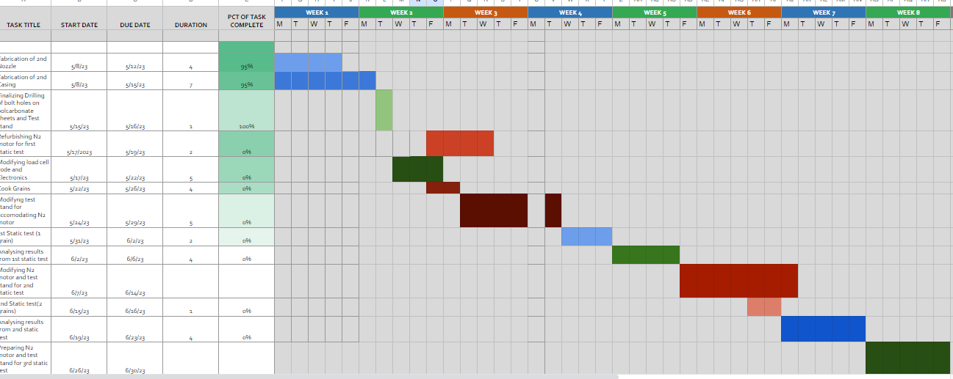
GANTT CHART
https://docs.google.com/spreadsheets/d/1hBBPNcnpQUVeR51bRd35yVVWFX5lDWHhBGYU0TpIXSk/edit#gid=0

Slide 9
CHALLENGES ENCOUNTERED
1. LOW TURN UP OF MEMBERS
2. INEFFECTIVE BORING TOOL

Slide 10
NEXT WEEK’S OBJECTIVES
1. COOK 1 FULL GRAIN
2. COMPLETELY ASSEMBLE THE TEST STAND
3. FURTHER RESEARCH ON THE USAGE OF BOLTS & O-RINGS JOINING METHOD.
4. FABRICATE 1 GRAIN MOTOR FOR 1ST STATIC TEST
5. FABRICATE N2 MOTOR FOR A MINIATURIZED STATIC TEST

